Slide 1
Design and Implementation of FPGA-based secured communication system
Presented by: Arsh Handa
Sonali Hooda

Slide 2
Chaos theory
Chaos Theory studies predictable systems that behave unpredictably due to extreme sensitivity to initial conditions (the Butterfly Effect). Though governed by fixed rules, tiny variations cause vastly different outcomes, making long-term forecasting impossible. Examples include weather, pendulums, and fractals. It reveals hidden patterns in nature while limiting predictability in complex systems.

Slide 3
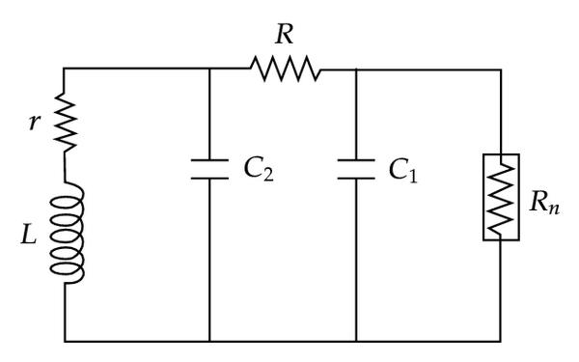
Chua circuit
Chua's circuit is a fundamental chaotic circuit combining linear elements consisting of inductor, resistors, capacitors with a crucial nonlinear resistor (Chua's diode). This nonlinear component, whose resistance varies with voltage/current, enables chaotic behavior. The complete circuit requires just 2 op-amps, 6 resistors, 2 capacitors, 1 inductor, and a tuning resistor. This simple yet powerful configuration makes Chua's circuit an ideal platform for studying chaos, demonstrating how deterministic systems can produce unpredictable, complex dynamics through nonlinearity. Its reliability and easily adjustable parameters have made it a cornerstone of chaos research in electronics.

Slide 4
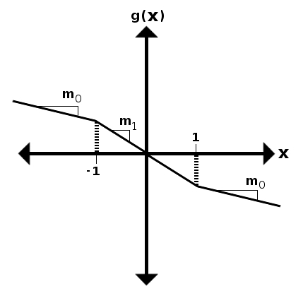
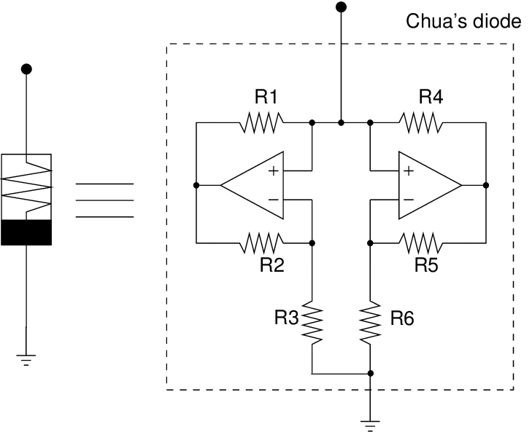
Non-linear resistor
The nonlinear resistor (Chua's diode) is the chaos-generating heart of the circuit. Unlike regular resistors, its resistance actively changes with voltage, creating a special negative resistance region in its current-voltage curve. This forces the circuit to fold and stretch its behavior unpredictably. Built using 2 op-amps + 6 resistors to create precise voltage-dependent resistance produces three distinct slopes in its response: two positive, one negative Enables chaotic effects like the double-scroll attractor without this carefully designed nonlinearity, Chua's circuit would behave as a predictable oscillator. The nonlinear resistor's voltage-sensitive switching is what makes it a classic chaos demonstration.

Slide 5
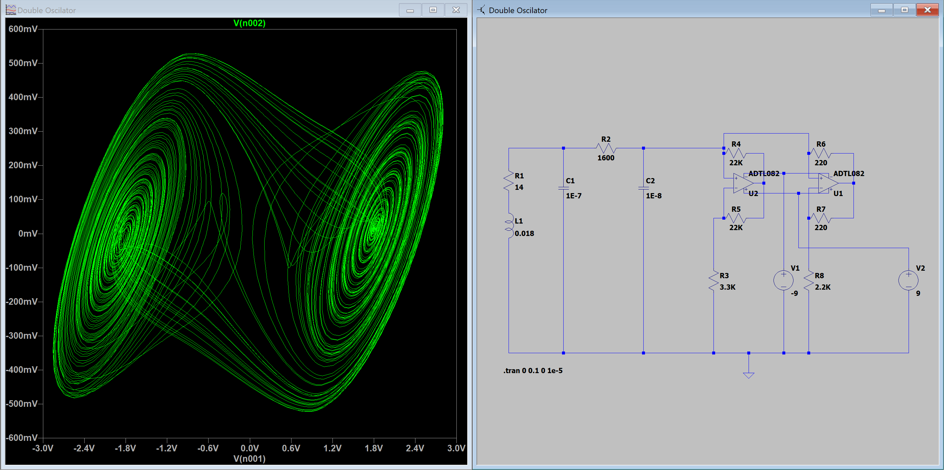
Chua circuit- LTspice simulation

Slide 6
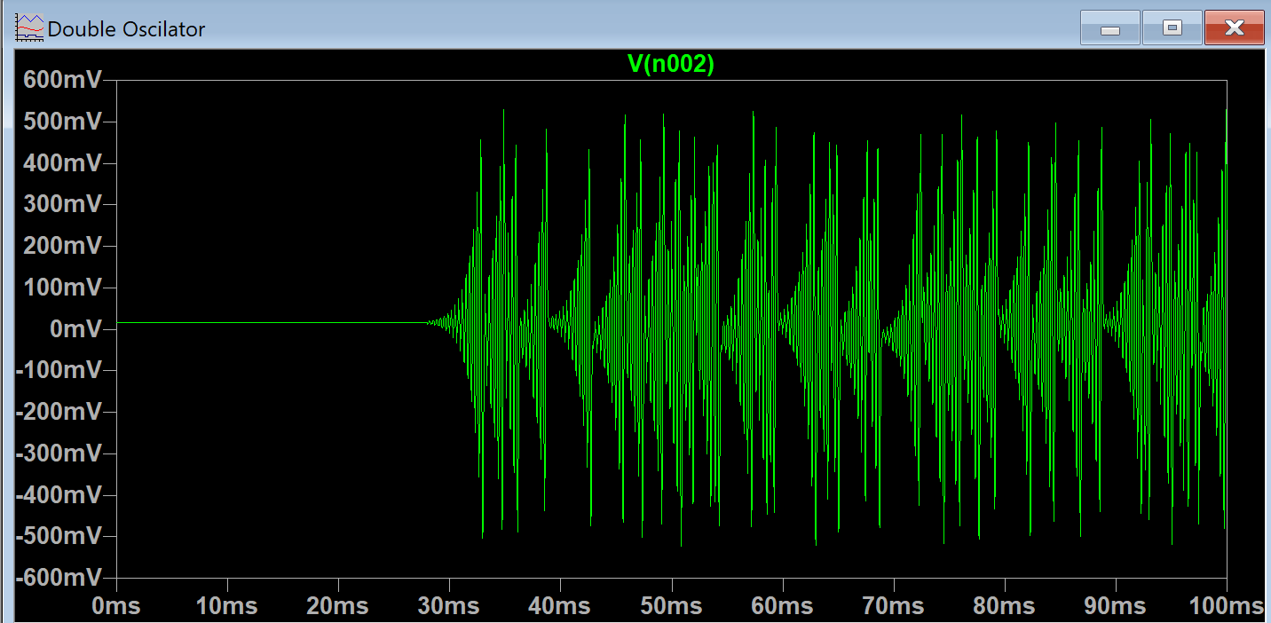
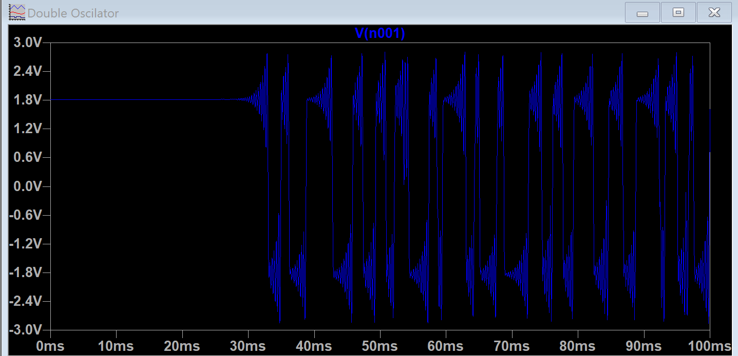
V2 against time
V1 against time

Slide 7
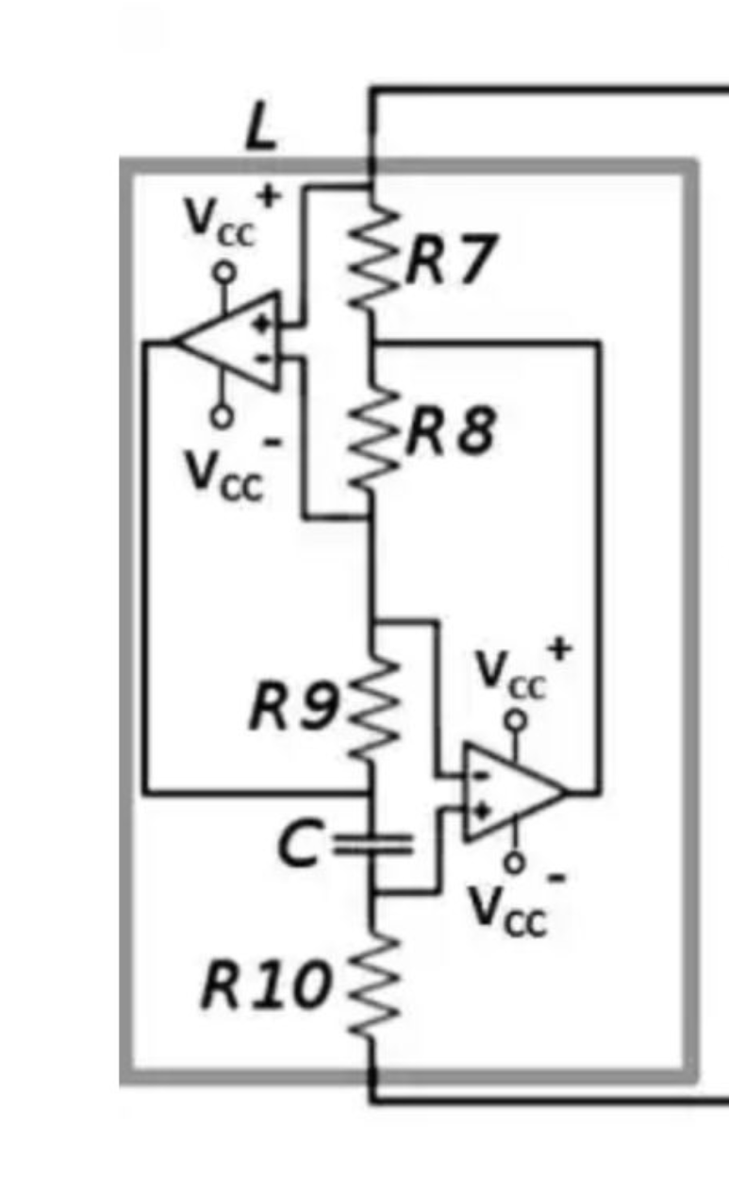
Inductor replaced Chua Circuits
The circuit replaces a physical inductor with an op-amp-based active inductor (using resistors R7-R10 and capacitors). This design:
Simulates inductance electronically (L_eq ≈ R7·R8·C) for compact, tunable chaos.
Avoids drawbacks of real inductors (size, parasitics, nonlinearity).
Preserves chaotic behavior (double-scroll attractor, bifurcations) identically to passive designs.
Ideal for ICs or experiments requiring precise, adjustable chaos.

Slide 8
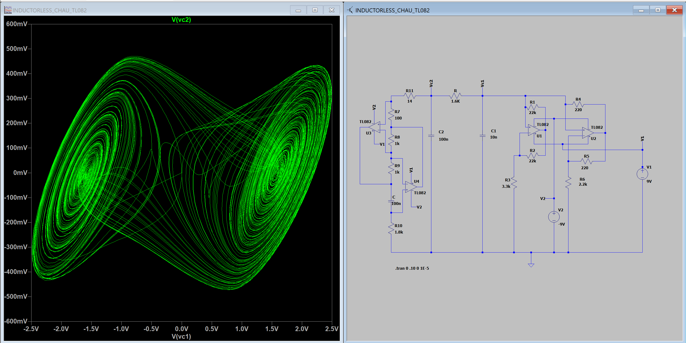
Inductor replaced Chua circuit- LTspice simulation

Slide 9
Multiscroll oscillator chua circuit
The Chua's Multiscroll Oscillator is an extension of the classic Chua's circuit, which is a well-known chaotic system. The nonlinearity (Chua’s diode) is redesigned to have multiple breakpoints (instead of just two in the classic case). This creates additional equilibrium points, each contributing to a new "scroll" in the chaotic attractor. The state variables (x,y,z) evolve according to coupled differential equations with a piecewise-linear (PWL) or smooth nonlinear function. As trajectories switch between different regions (due to the modified nonlinearity), they spiral around multiple unstable fixed points, generating 3, 4, or even more scrolls. The system is more complex and useful for applications like secure communications, random number generation, and chaos-based encryption.

Slide 10
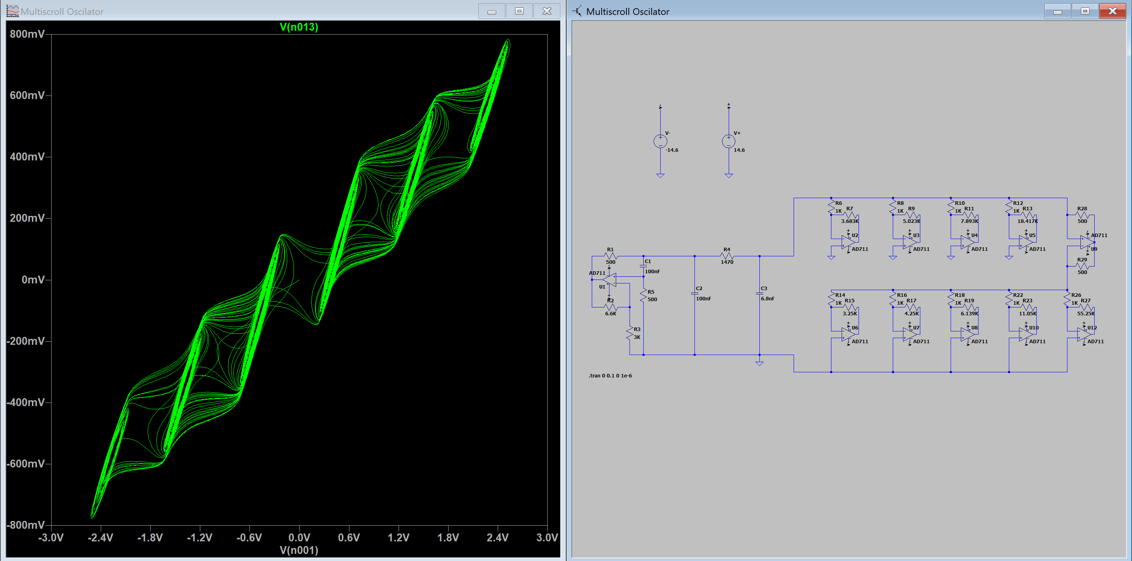
Multiscroll Chua oscillator

